Slide 1
The UK

Slide 2
IRELAND

Slide 3
THE UNITED STATES OF AMERICA

Slide 4
CANADA

Slide 5
AUSTRALIA

Slide 6
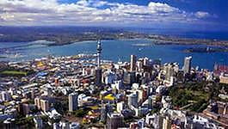
New Zealand

Slide 7
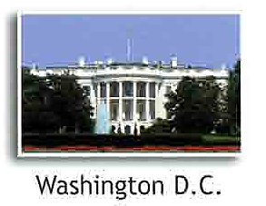

Slide 9
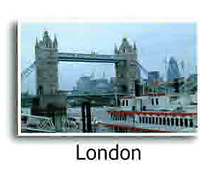

Slide 11
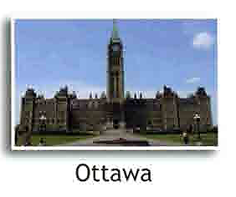

Slide 12
