Slide 1
Buying a souvenir

Slide 2
What we are going to do…
Introduce and practice language for buying a souvenir

Slide 3
Revise vocabulary for names of souvenirs of the UK
Revise Plural forms
Revise rules for have/ has got/, haven’t/hasn’t got

Slide 4
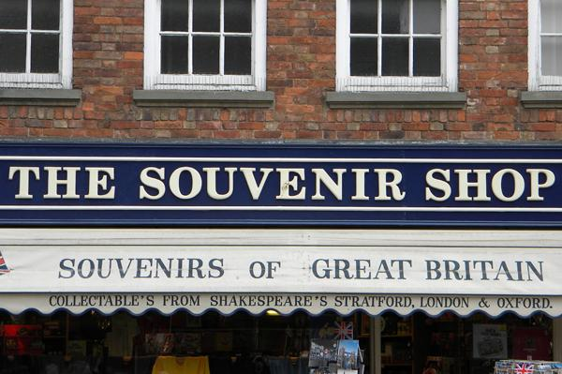
The situation:
You are at a souvenir shop in the UK

Slide 5
The situation:
You are сustomers who would like to buy a souvenir at a souvenir shop

Slide 6
What should we know to buy a souvenir there?

Slide 7
We should know the names
of souvenirs

Slide 8
We should know polite phrases for buying souvenirs

Slide 9
What is the main aim of this lesson?

Slide 10
The main aim of this lesson is to find out what phrases people use to buy a souvenir at a souvenir shop.

Slide 11
Let’s check your home task

Slide 12
Brainstorming

Slide 13
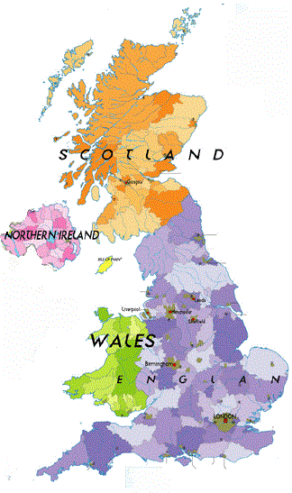
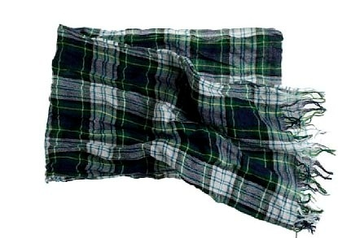
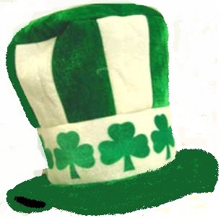
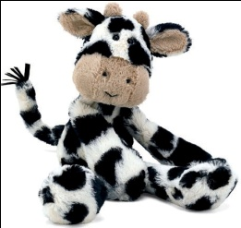
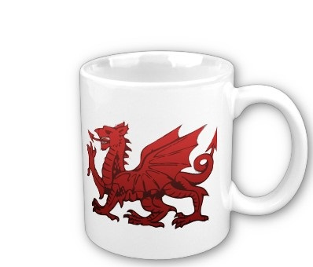
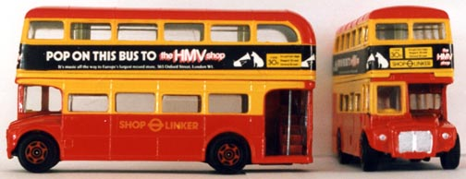
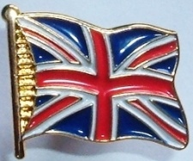
SCARF
This is a tartan scarf from Scotland. Tartan cloth is very popular in Scotland.
HAT
This is a hat. It has got shamrock on it. The shamrock is the national symbol of Ireland.
STUFFED TOY
This is a stuffed toy. It looks like a cow. There are many cows in Scotland.
UK
TOY BUSES
These are toy buses. They are double-decker buses. You can see these in London.
MUG
This is a mug. It has got a Welsh dragon on it. The Welsh dragon is on the flag of Wales.
PIN
This is a pin. It has got a Union Jack on it. The Union Jack is the flag of the UK.

Slide 14
Practice makes perfect

Slide 15
a mug, a bus, a stuffed toy, a hat, a magnet, an umbrella, a flag, a dragon, a key ring, a T-shirt, a CD, a pin, a bell, a doll, a scarf

Slide 16
Write the plurals.
-s:
-es:
-ves:

Slide 17
Let’s check up.
mugs, buses, stuffed toys, hats, magnets, umbrellas, bells, flags, dragons, key rings, T-shirts, CDs, pins, scarves

Slide 18
Fill in has, hasn’t, have, haven’t.
………..they got a magnet?
Yes, they ………….. .
2. …………he got a scarf?
No, he …………. .
3. …………Bill got a key ring?
Yes, he ………….. .
4. …………….you got a pin?
No, I ……………….. .

Slide 19
Which sentences does the shop assistant say?
Which does the customer say?
  How can I help you?
  How about this key ring?
  I want to buy a souvenir.
  Here you are.
  How much is it?
  It’s 4 pounds.

Slide 20
What is the English for:
Я хочу купить сувенир?
I want to buy a souvenir?
Чем я могу вам помочь?
How can I help you?
Сколько это стоит?
How much is it?
5 фунтов.
It’s 5 pounds.
Возьмите.
Here you are.

Slide 21
Let’s try to act out several dialogues between
a customer and the shop assistant.

Slide 22



Leave a tip for me
The information is interesting, I can easily use it in practice.
The information is interesting, but I have some problems to use it in practice
The information is difficult to understand

Slide 23
Thank you for
the lesson!
Good-bye!

