Slide 1
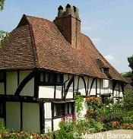
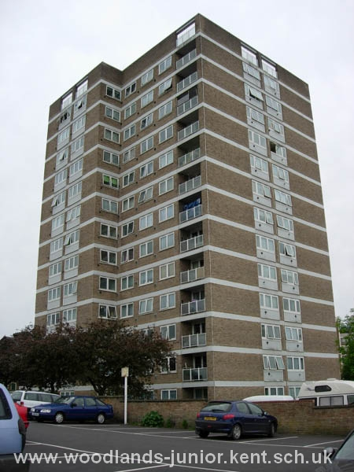
The Typical British Houses

Slide 2
Most people in England live in urban(городской) areas. Towns and cities are spreading into their surrounding environment to cope with the increase populations. In England, an average of 7,000 hectares of farmland, countryside and green space were converted to urban use every year between 1985 and 1998. This is almost the equivalent size of 9,600 international football pitches!
This house is over 600 years old

Slide 3
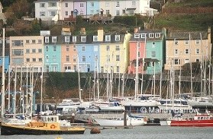
Who owns houses in England?
More people are buying their own homes than in the past. About two thirds of the people in England and the rest of Britain either own, or are in the process of buying, their own home. Most others live in houses or flats that they rent from a private landlord, the local council, or housing association.

Slide 4
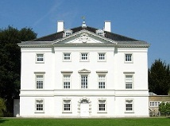
People buying their property almost always pay for it with a special loan called a mortgage(ипотека), which they must repay, with interest, over a long period of time, usually 25 years.

Slide 5
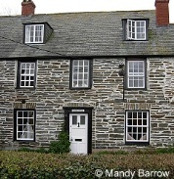
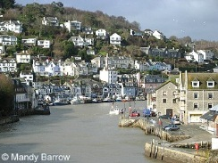
What are houses in England like?
Most houses in England are made of stone or brick from the local area where the houses are built. The colors of the stones and bricks vary across the country.

Slide 6
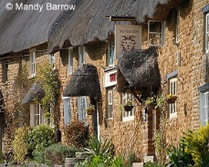
Types of houses in England
England has many types of homes. In the large cities, people often live in apartments, which are called flats. In most towns, there are streets of houses joined together in long rows. They are called terraced houses.

Slide 7
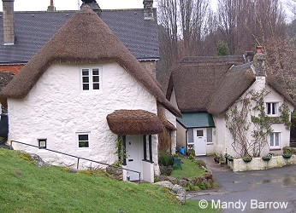
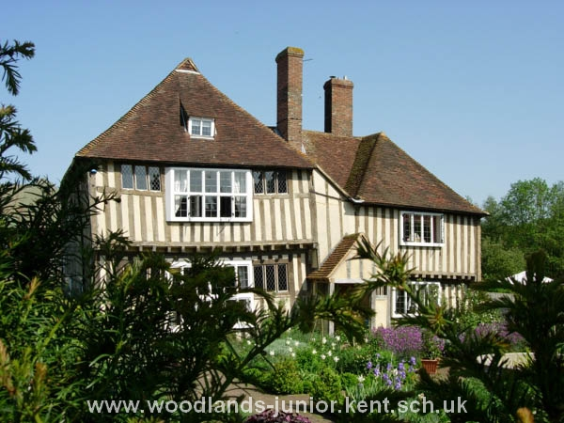
The main types of houses in England are:
Detached (a house not joined to another house).

Slide 8
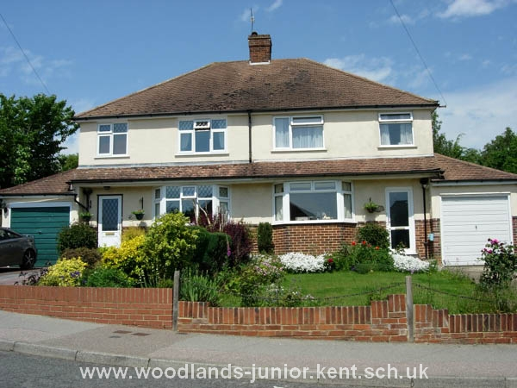
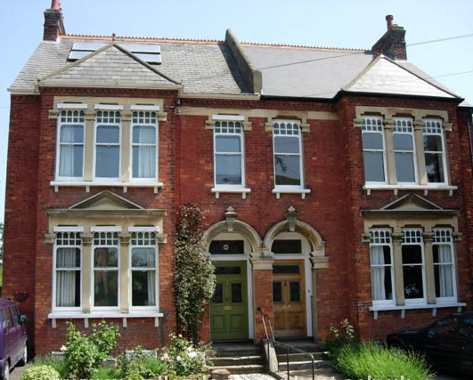
Semi-detached (two houses joined together). A semi-detached house is a house which is joined to another house on one side.

Slide 9
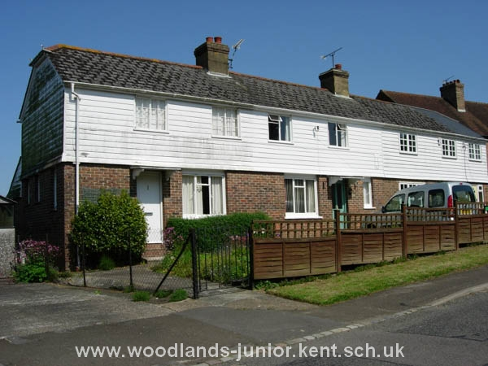
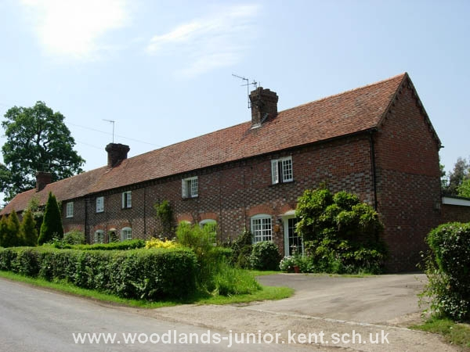
Terrace (several houses joined together).
In most towns in England, there are streets of houses joined together in long rows. They are called terrace houses (terraced houses). Lots of these have small gardens at the back.

Slide 10
A Block Flats (apartments)
A flat is part of a bigger building where all the flats share a front door. Only cities and very big towns have flats like the one you can see below.

Slide 11
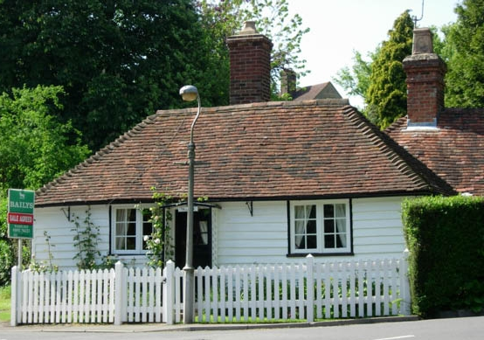
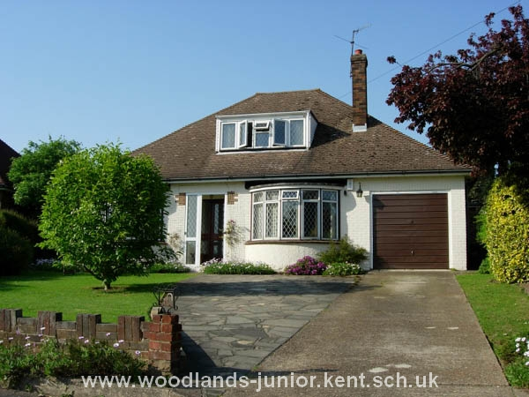
A Bungalow
A bungalow is a house which is only on one floor, no stairs. It may be joined to another bungalow or might stand alone.
The bungalow pictured below is made from white wooden planks. It is called a weatherboarded bungalow.

Slide 12
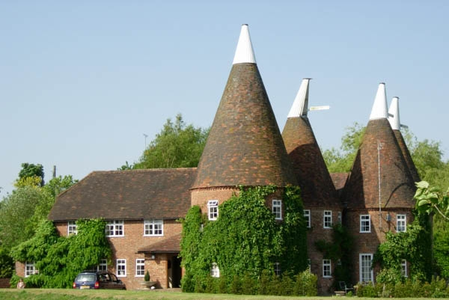
Oast House
Many people in England live in buildings which were once built for something else other than a home. Oast Houses were not originally a building where people lived. They were part of farm buildings and were where hops (a plant from which beer is made) were layed out and dried.

Slide 13
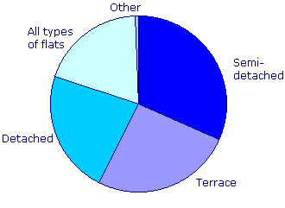
Census 2001: Housing
The most popular type of home in England is semi-detached (more than 27% of all homes), closely followed by detached then terraced.

Slide 14
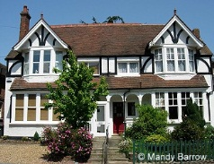
Almost half of London's households are flats, maisonettes or apartments.

Slide 15
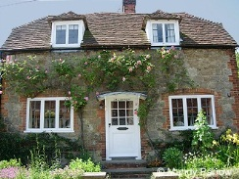
Cost of Houses
A big problem in England is the rising cost of houses. In 1989 first-time buyers paid an average of around £40,000, in 2001 this had more than doubled to £85,000 and in 2006 to £151,565.
The cost of housing in England has increased much faster than people's wages making it impossible for first-time buyers to get on the housing ladder unless they are in especially well-paid jobs, are able to call upon rich relatives or are prepared to buy jointly with friends.

Slide 16
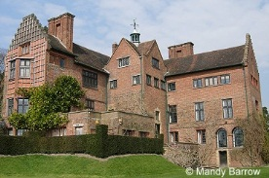
Cost of Houses in 2005-2007
Average Cost: £182,920
Detached: £282,157
Semi-detached: £169,074
Terraced: £139,122
Flat: £168,571
Average Cost: £184,924
Detached: £285,697
Semi-detached: £170,650
Terraced: £143,512
Flat: £174,052
Chartwell House - Winston Churchill once lived here

