Slide 1
Larry

Slide 2
Lulu

Slide 3
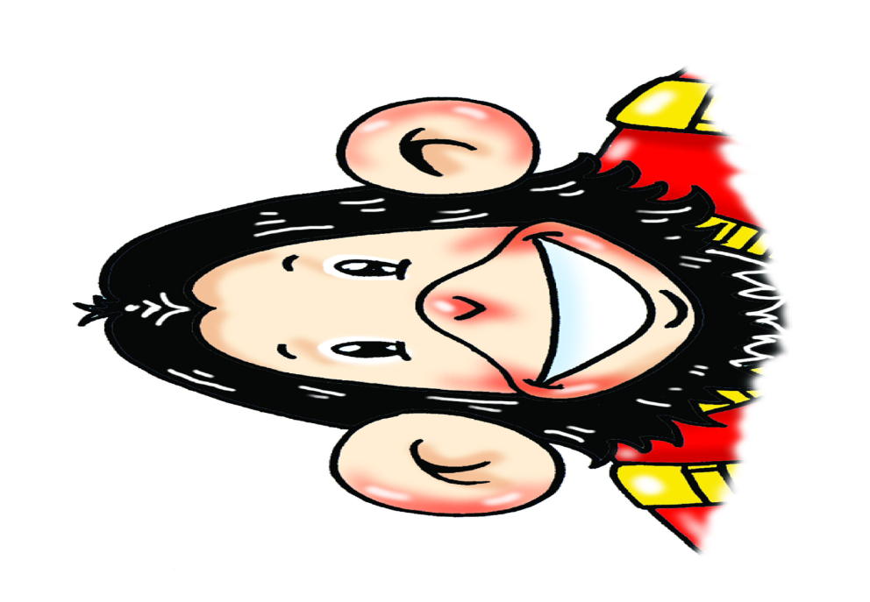
Chuckles

Slide 4
Nanny Shine

Slide 5
I’m Larry.

Slide 6
This is my sister Lulu.

