Slide 1
Going shopping
Shops and products

Slide 2
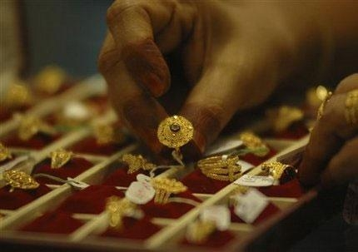
Jeweller’s
Bakery
Florist’s
Café
Shoe shop
Newsagent’s
Greengrocer’s
Toy shop
Book shop
Chemist’s
Record shop
Fast food restaurant
Clothes shop
Jeweller’s

Slide 3
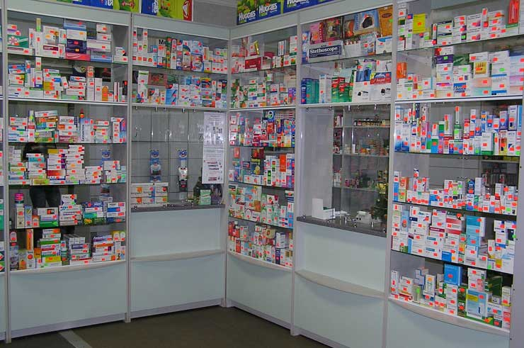
Chemist’s
Bakery
Florist’s
Café
Shoe shop
Newsagent’s
Greengrocer’s
Toy shop
Book shop
Chemist’s
Record shop
Fast food restaurant
Clothes shop
Jeweller’s

Slide 4
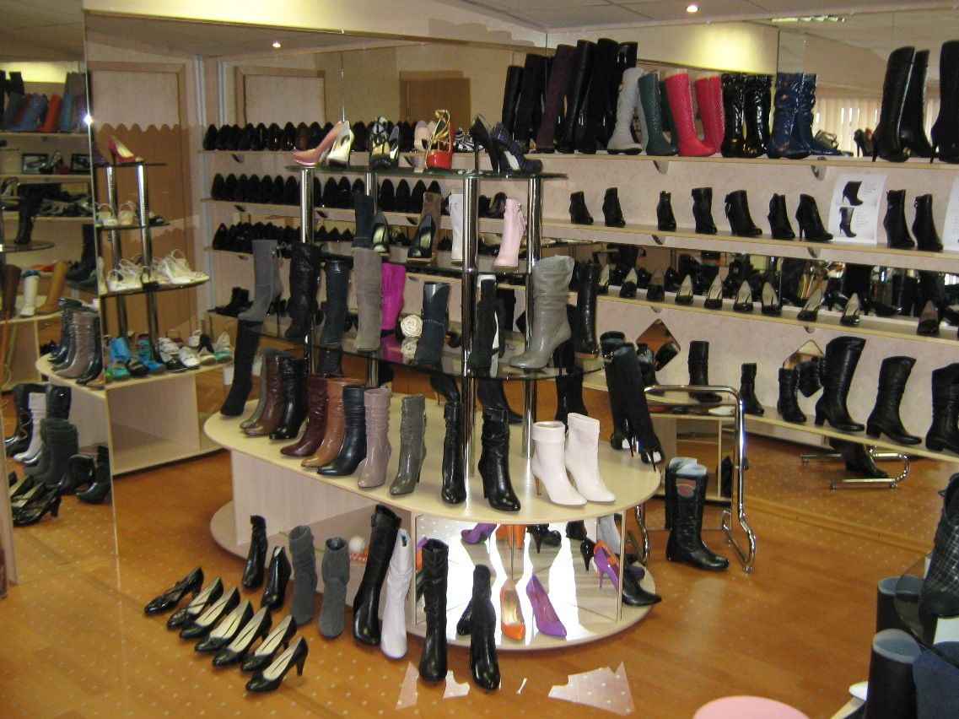
Shoe shop
Bakery
Florist’s
Café
Shoe shop
Newsagent’s
Greengrocer’s
Toy shop
Book shop
Chemist’s
Record shop
Fast food restaurant
Clothes shop
Jeweller’s

Slide 5
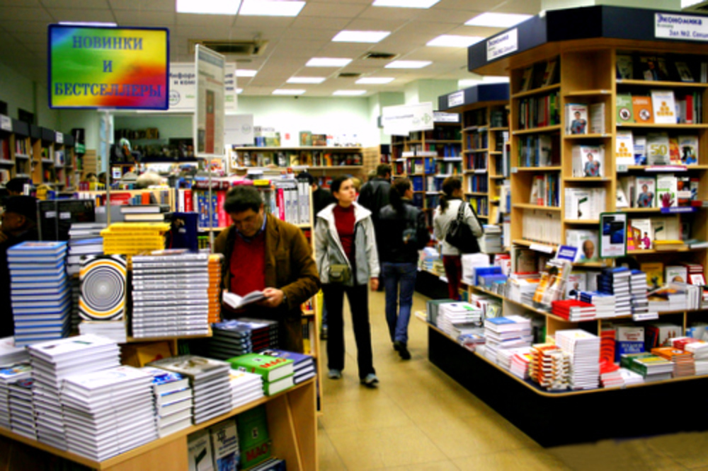
Book shop
Bakery
Florist’s
Café
Shoe shop
Newsagent’s
Greengrocer’s
Toy shop
Book shop
Chemist’s
Record shop
Fast food restaurant
Clothes shop
Jeweller’s

Slide 6
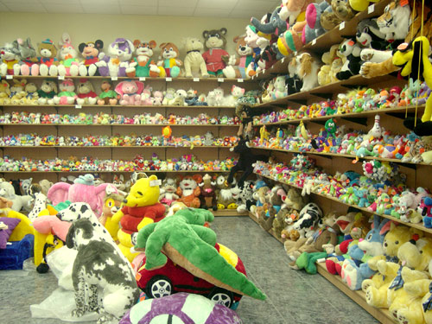
Toy shop
Bakery
Florist’s
Café
Shoe shop
Newsagent’s
Greengrocer’s
Toy shop
Book shop
Chemist’s
Record shop
Fast food restaurant
Clothes shop
Jeweller’s

Slide 7
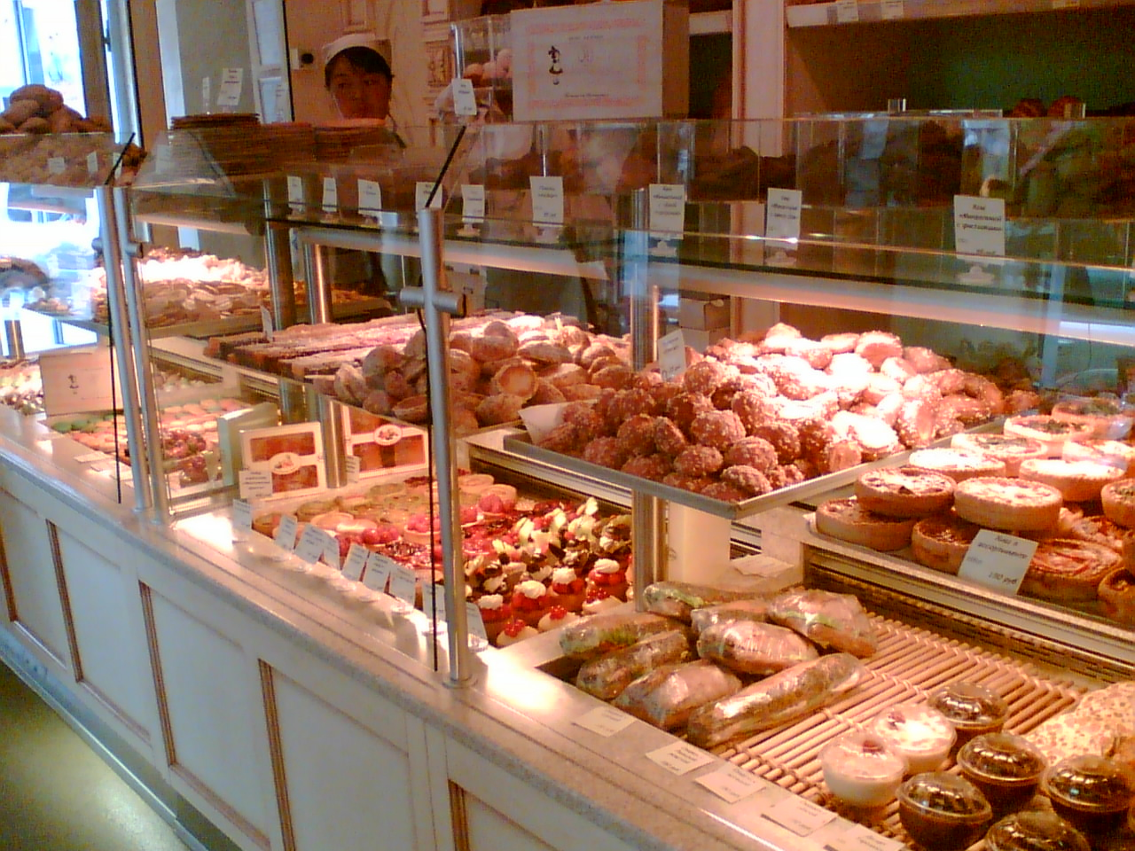
Bakery
Bakery
Florist’s
Café
Shoe shop
Newsagent’s
Greengrocer’s
Toy shop
Book shop
Chemist’s
Record shop
Fast food restaurant
Clothes shop
Jeweller’s

Slide 8
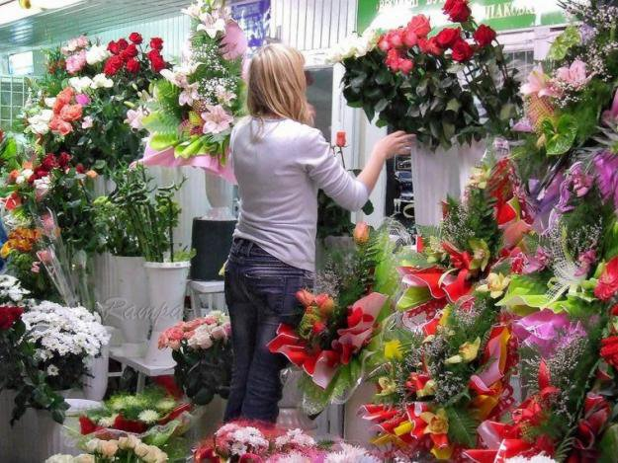
Florist’s
Bakery
Florist’s
Café
Shoe shop
Newsagent’s
Greengrocer’s
Toy shop
Book shop
Chemist’s
Record shop
Fast food restaurant
Clothes shop
Jeweller’s

Slide 9
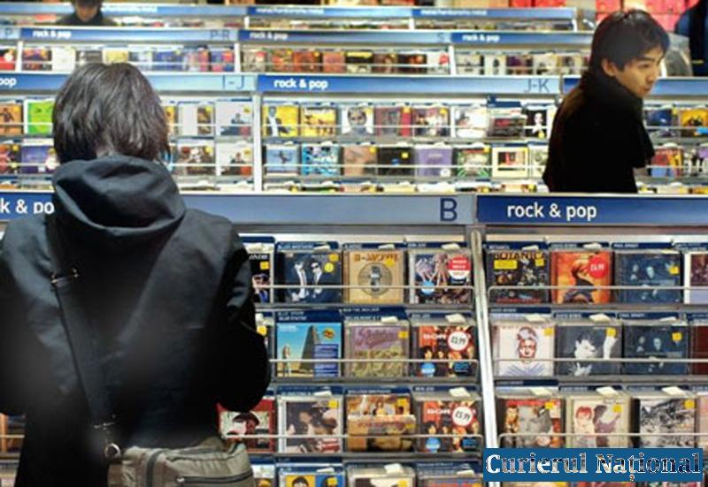
Record shop
Bakery
Florist’s
Café
Shoe shop
Newsagent’s
Greengrocer’s
Toy shop
Book shop
Chemist’s
Record shop
Fast food restaurant
Clothes shop
Jeweller’s

Slide 10
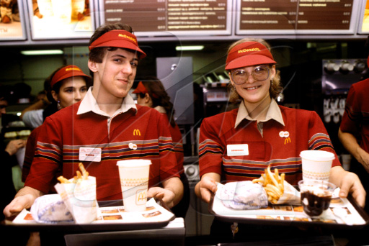
Fast food restaurant
Bakery
Florist’s
Café
Shoe shop
Newsagent’s
Greengrocer’s
Toy shop
Book shop
Chemist’s
Record shop
Fast food restaurant
Clothes shop
Jeweller’s

Slide 11
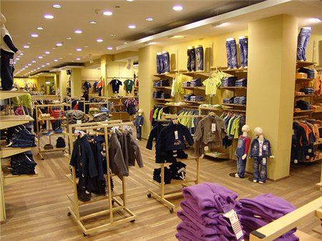
Clothes shop
Bakery
Florist’s
Café
Shoe shop
Newsagent’s
Greengrocer’s
Toy shop
Book shop
Chemist’s
Record shop
Fast food restaurant
Clothes shop
Jeweller’s

Slide 12
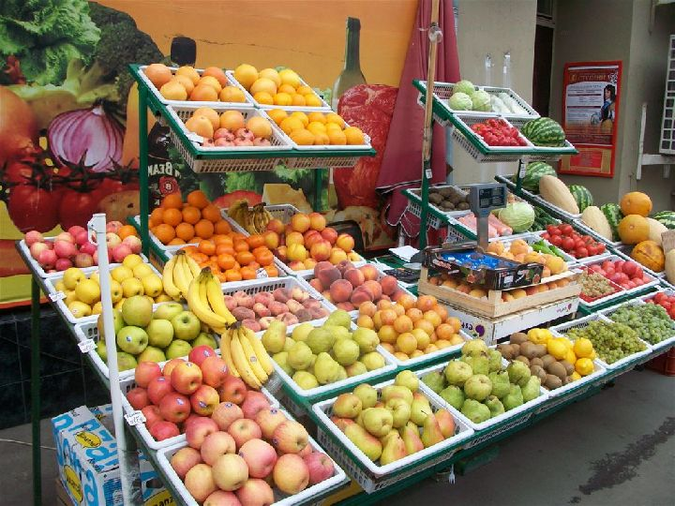
Greengrocer’s
Bakery
Florist’s
Café
Shoe shop
Newsagent’s
Greengrocer’s
Toy shop
Book shop
Chemist’s
Record shop
Fast food restaurant
Clothes shop
Jeweller’s

Slide 13
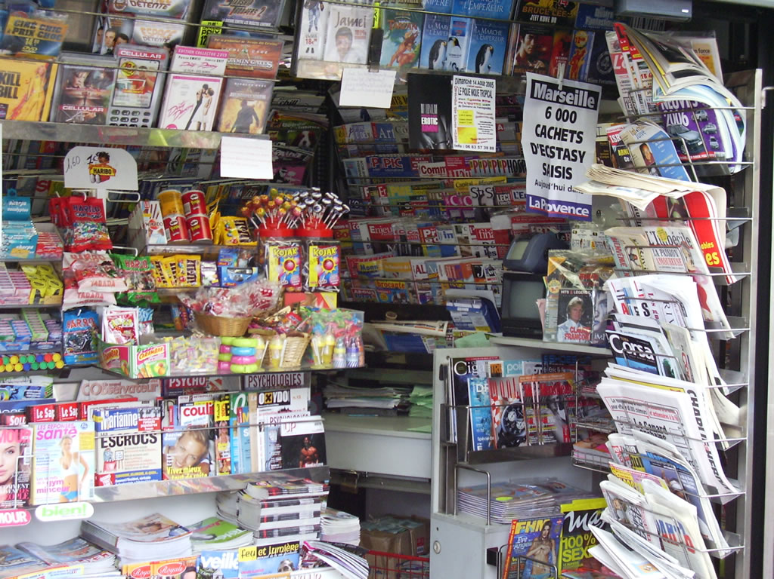
Newsagent’s
Bakery
Florist’s
Café
Shoe shop
Newsagent’s
Greengrocer’s
Toy shop
Book shop
Chemist’s
Record shop
Fast food restaurant
Clothes shop
Jeweller’s

Slide 14
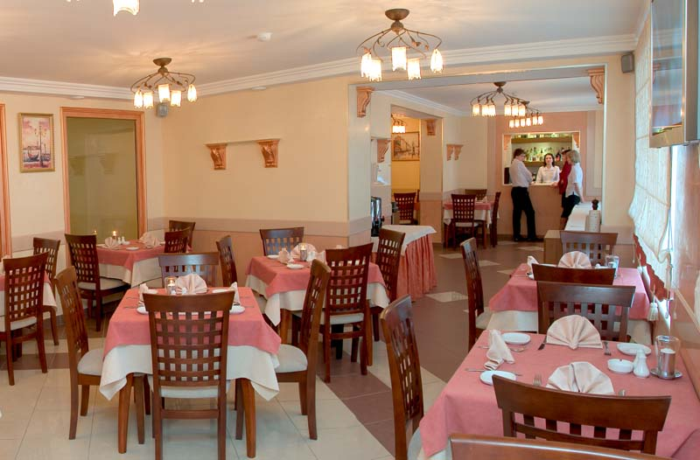
Café
Bakery
Florist’s
Café
Shoe shop
Newsagent’s
Greengrocer’s
Toy shop
Book shop
Chemist’s
Record shop
Fast food restaurant
Clothes shop
Jeweller’s

