Slide 1

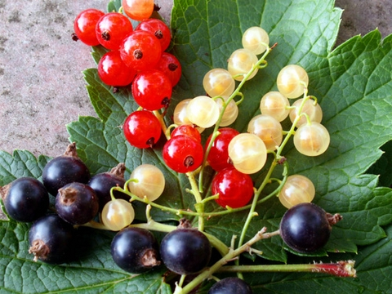
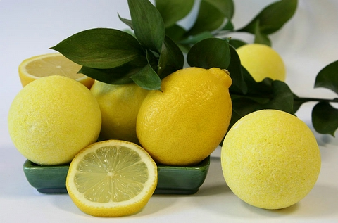
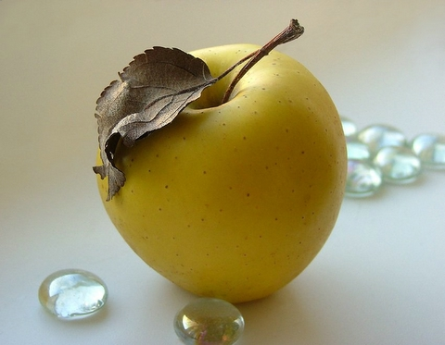
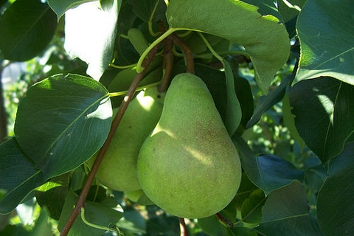
«Healthy
eating»

Slide 2
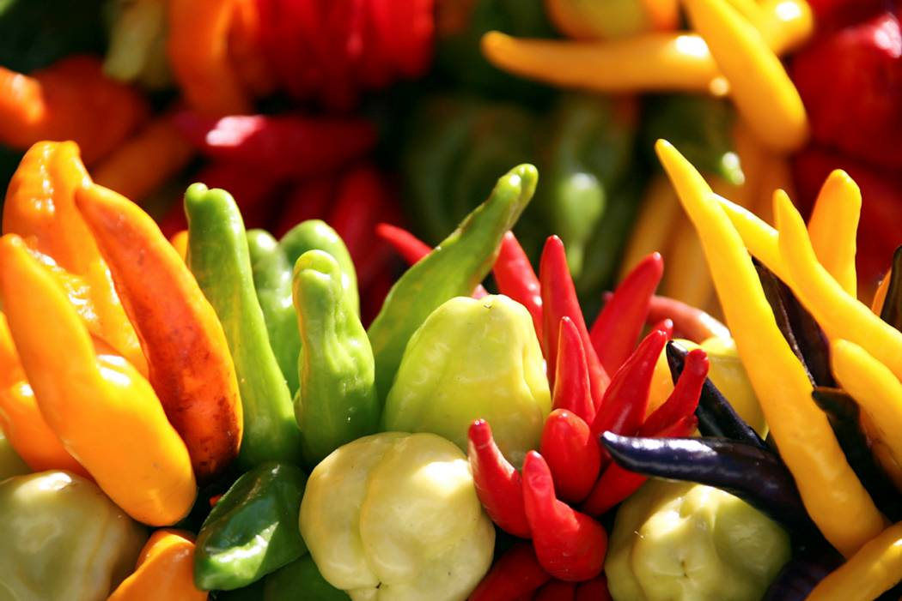
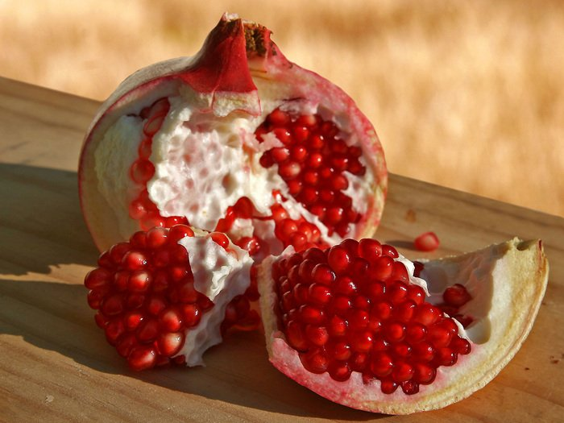
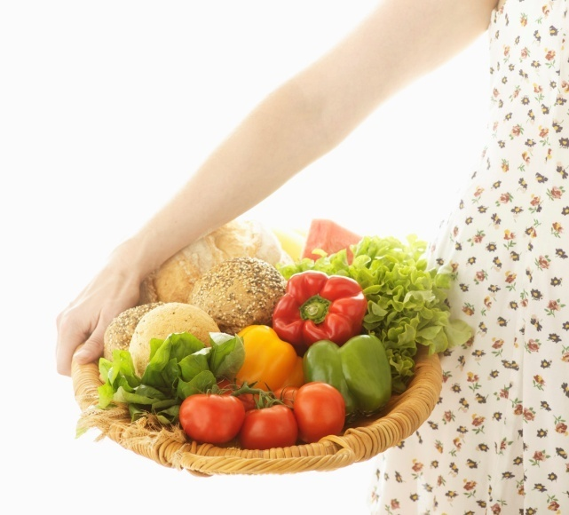
«The Man is What He Eats»
We have to think of our health.
It is not difficult.
Healthy eating plays an important role.

Slide 3
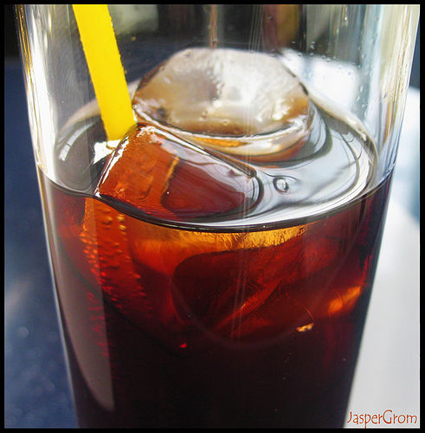
Fizzy drinks contain a lot of harmful things.
There is a lot of sugar there. It’s not good for your teeth.
От нее, от Кока-колы
Лишь желудок будет полным,
А полезности ни грамма,
Создана лишь для рекламы.

Slide 4
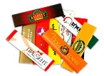



Chewing gums.
Chewing gums are harmful for stomachs

Slide 5
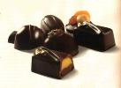

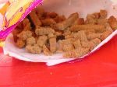
You shouldn’t eat a lot of chocolate sweets.
Crisps and snack are not useful.

Slide 6
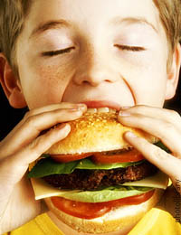
To be or not to be?
One of the main reasons of obesity is fast food
There is a lot of fat in this kind of food.

Slide 7
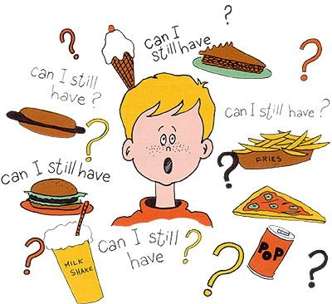
What should we eat?

Slide 8
Do not eat a lot !

Slide 9
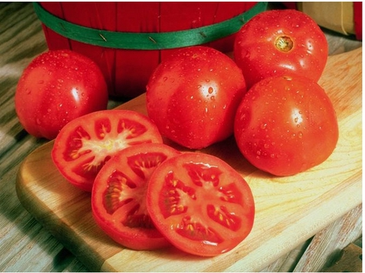
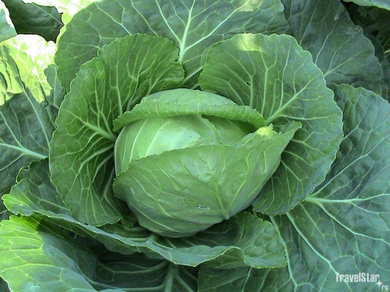
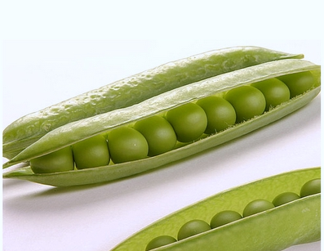
Vegetables and fruit are very useful for our health. They contain a lot vitamins and minerals.

Slide 10
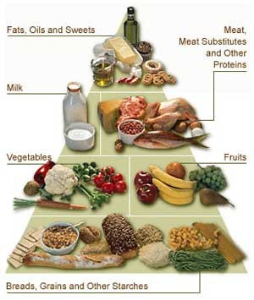

Slide 11
Eat healthy food

Slide 12
7.00 – Coffee 10.00 – Sandwiches 12.00 – Snacks(pasta) 14.00 – Crisps, Cola 18.00 – Crisps 20.00 – Great Dinner.
Refuse of snacks
Eat healthy food!
8.15 – Breakfast.
13.25 – Lunch. 17.20 – Tea Break. 19.40 – Dinner.
20.55 – Tea Break

Slide 13

Breakfast in the morning,
Dinner in the day,
Tea comes after dinner,
Then comes time to play!
Supper in the evening
When the sky is red.
Then the day is over
And we go to bed.
Eat healthy food

Slide 14
