Slide 1
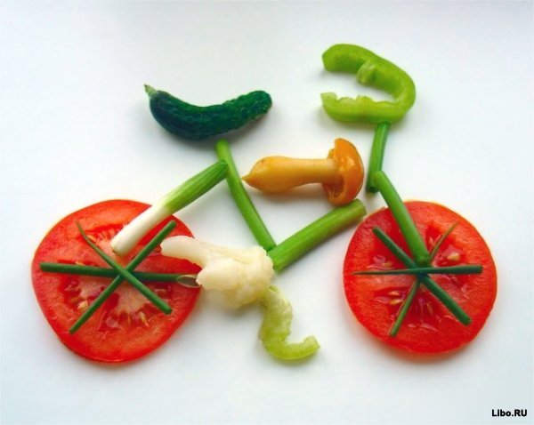
EAT WELL, FEEL GREAT, LOOK GREAT

Slide 2
SAYINGS AND PROVERBS ABOUT HEALTHY FOOD
An apple a day keeps a doctor away
A smiling face is half the meal
More die of food than famine
You are what you eat
Eat to live, not live to eat
Your food is your medicine

Slide 3
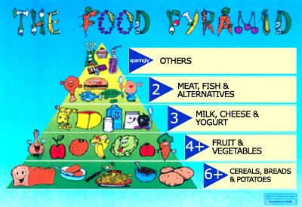
FOOD PYRAMID

Slide 4
NEW WORDS
is based on –
fibre –
grains –
iron -
at least –
plenty of –
potassium –
calcium –
to consume –
to include –
magnesium –
protein –
heart disease –

Slide 5
NEW WORDS
is based on – основываться на ч.-л.
fibre – пищевые волокна, клетчатка
grains – зерновые
iron - железо
at least – по крайней мере
plenty of – очень много
potassium – калий
calcium –кальций
to consume – потреблять
to include – включать, содержать
magnesium – магний
protein – белок, протеин
heart disease – болезни сердца

Slide 6
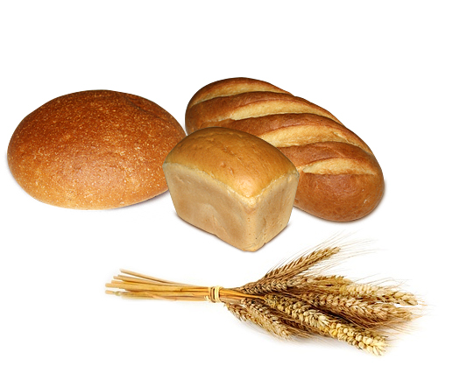
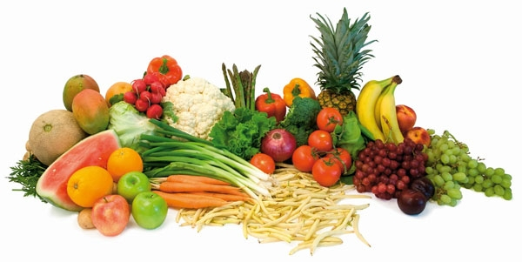
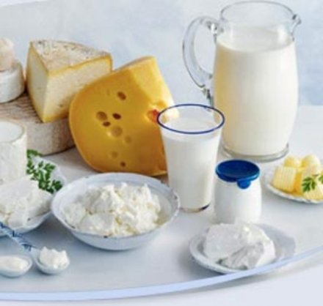
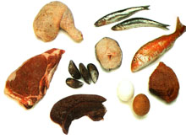
In what food we can find:
FIBRE IRON VITAMIN POTASSIUM CALCIUM PROTEIN FATS MAGNESIUM

Slide 7
In what food we can find:
FIBRE IRON VITAMIN POTASSIUM CALCIUM PROTEIN FATS MAGNESIUM
VITAMIN
VITAMIN
CALCIUM
IIIIRON
POTASSIUM
VITAMIN
FIBRE
IIIIRON
Magnesium
FATS
PROTEIN

Slide 8
Answer the questions.
1. Why do you need to have bread and grains every day?
2. What can you get potassium from?
3. What can help you prevent heart disease?
4. What do you get from meat, fish and beans?
5. What products do you need to consume to protect your bones? Why?

Slide 9
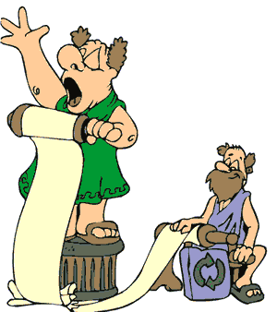
I think/don`t think
(name) yesterday was a junk food junkie/a health food nut
because he ate.......

