Slide 1
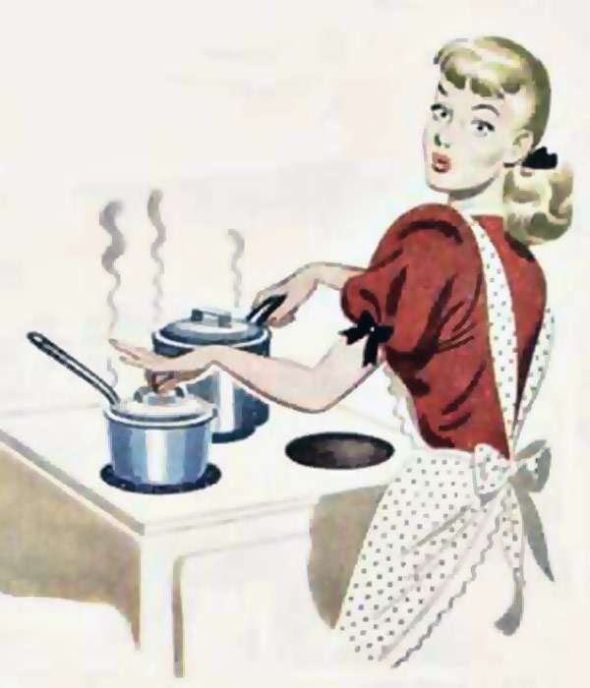
cooking

Slide 2
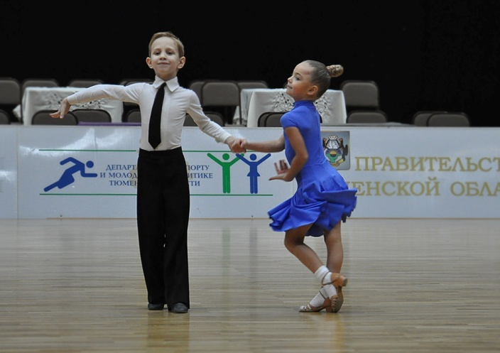
dancing

Slide 3
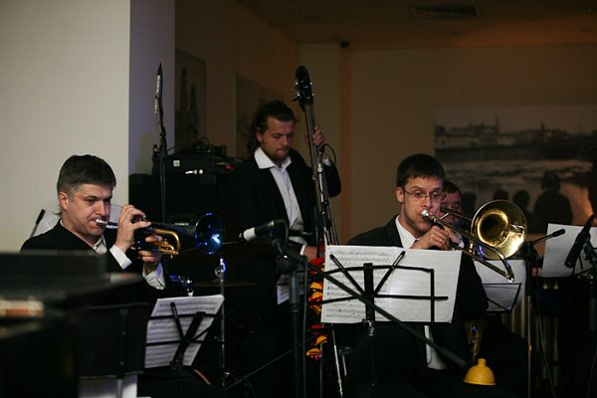
jazz

Slide 4
painting

Slide 5
person
личность, фигура

Slide 6
profile

Slide 7
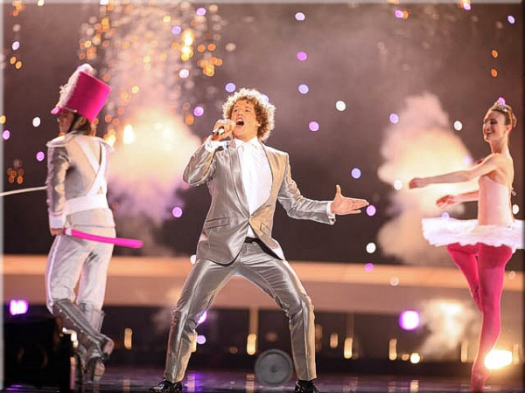
singer, singing

Slide 8
young
молодой

