Slide 1
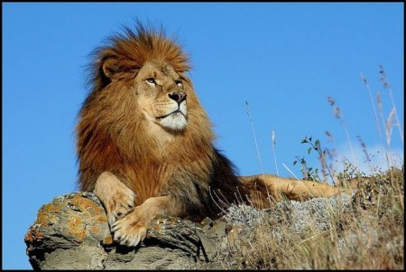
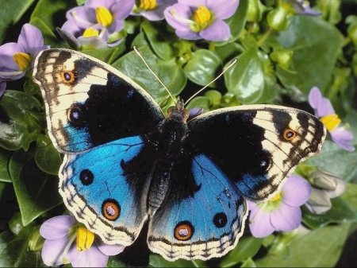
“Amazing animals”

Slide 2
NAME
(My name is …)
AGE
(I’m … years old.)
FAVOURITE ANIMAL
(My favourite animal is …)

Slide 3
English Alphabet
A B C D E F G H I J K L M,
I can sing the alphabet,
Can you do the same?
I can sing the alphabet,
I’ve got it in my head!
N O P Q R S T U V W X Y Z!

Slide 4
Animal Alphabet
A B C D E F G
H I J K L M N
O P Q R S T U
V W X Y- yaks Z

Slide 5
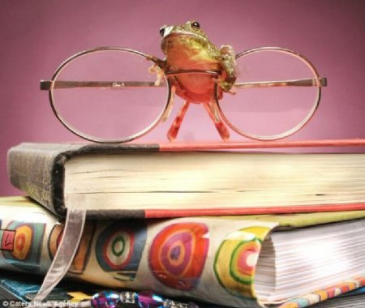

Slide 6
I am a big bear.
My fur is blue.
I have got six paws and a long green tail like a crocodile.
My ears are very big like an elephant.

Slide 7
I am a big bird.
My feathers are red, but my wings are yellow.
I have got a blue tail like a fish and a long neck like a goose.

Slide 8
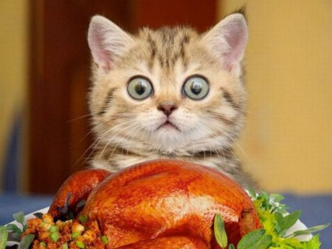

Slide 9
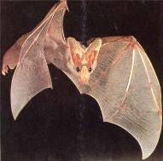
“Hidden words”
Close the door at once!
Close the door at once!
rat

Slide 10
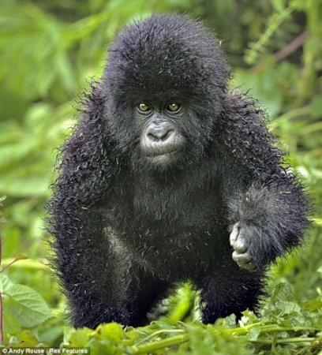

Slide 11
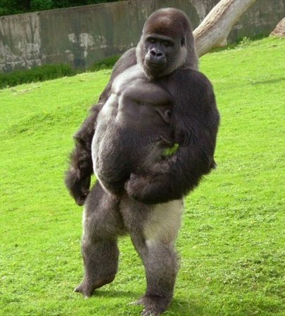
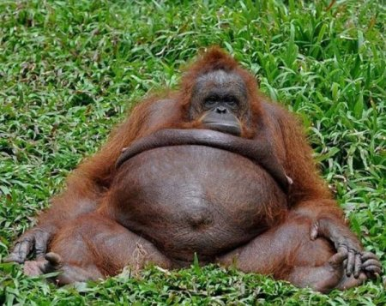

Slide 12
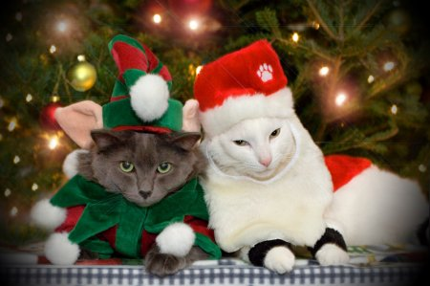
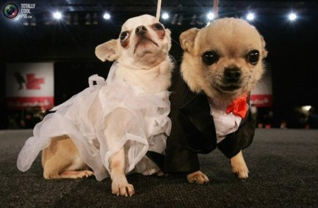

Slide 13
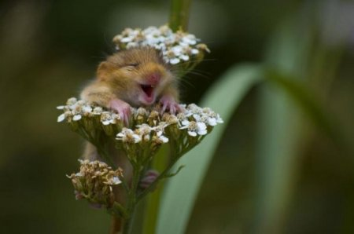
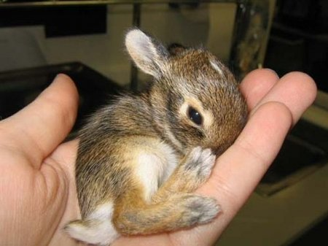

Slide 14
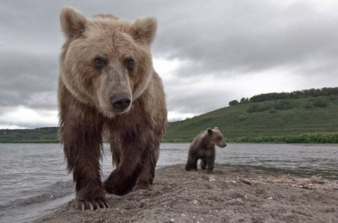
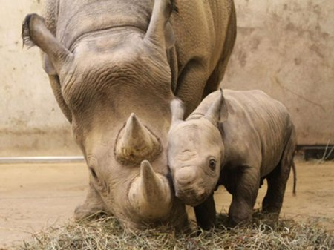

Slide 15
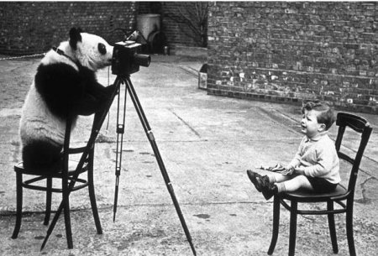

Slide 16
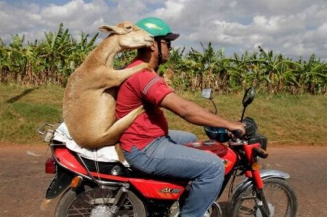
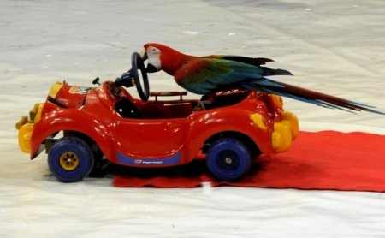

Slide 17
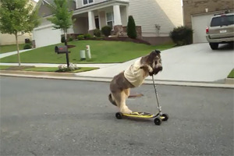
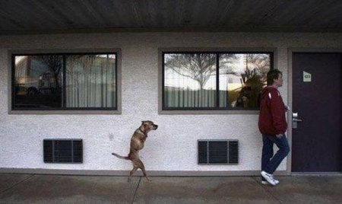

Slide 18
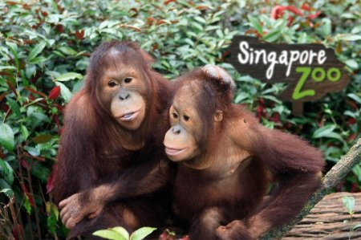
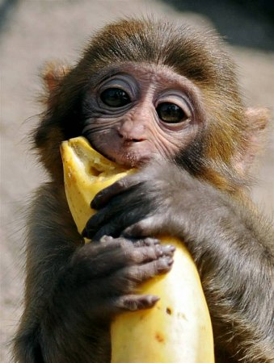

Slide 19
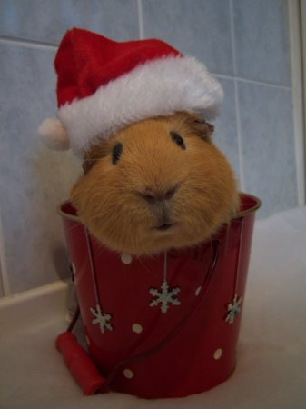

Slide 20
Good bye!

